Slide 1
Machine Learning -
Basic Principles & Practice
7. Occam’s Razor
机器学习 - 基础原理与实践
7. 奥卡姆剃刀
Cong Li 李聪

Slide 2
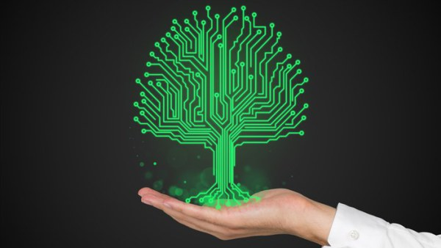
Should You Still Remember …
倘若你依然记得……
Sense 词义 | Example 例句
兴趣 | Reading is one of my interests
利益 | In this case, my interests conflict with yours
利息 | The Fed cut interest rates again
… | …
Best performance achieved using a selected set of most useful attributes
选择一部分最有用的属性时取得了最佳效果

Slide 3
Reality 现实
The ‘Best’ Performance 该“最佳”效果
  Typically not achievable in practice
  实践中往往很难实现
Reasons 原因
  Difficult to rate attribute importance
  难以衡量属性的重要性
  Difficult to determine attribute number 难以确定属性数量
    Too few attributes → bad performance even w/ large amount of data 属性太少 → 即便训练数据再多也难以取得好的效果

Slide 4
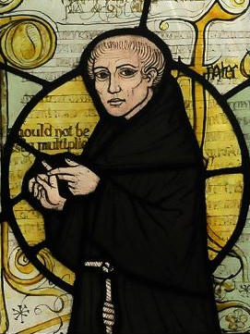

Can We Do Better?
我们能做得更好吗？
It’s Not Easy 这并不简单
Introduce a New Principle
引入一个新原则
  Occam’s Razor by Philosopher William of Ockham 哲学家奥卡姆的威廉的奥卡姆剃刀

Slide 5
Different Formulations
不同的表述
Entities should not be multiplied without necessity.
若无必要，勿增实体。
The simplest solution is most likely the right one.
最简单的方案极可能是恰当的方案。
When presented with competing hypotheses that make the same predictions, one should select the solution with the fewest assumptions.
当面对多种能作出同样准确的预言的论断时，那么应该挑选其中使用假设最少的。

Slide 6
In Machine Learning
在机器学习中
Make the Same Predictions
作出同样准确的预言
  Perform similarly on training data
  在训练数据上表现类似
The Fewest Assumptions 假设最少的
  Assumption to make classifiers ‘simple’, e.g., 使候选分类器“简单”的假设，例如
    Use fewest attributes 用最少的属性
    ‘Classification capability’ of the candidate classifier set is weak
    候选分类器集合的“分类能力”弱

Slide 7
Illustration: Fewer Attributes
说明：更少的属性 (1)
  Attribute 2 属性2
Use both attributes
用两个属性
  Attribute 1
  属性1

Slide 8
Illustration: Fewer Attributes
说明：更少的属性 (1)
  Attribute 2 属性2
Use only 1 attribute
只用一个属性
  Attribute 1
  属性1

Slide 9
Illustration: Fewer Attributes
说明：更少的属性 (1)
  Attribute 2 属性2
Which category of classifiers is simpler?
哪种类型的分类器更简单？
  Attribute 1
  属性1
Which category’s classification capability is weaker?
哪种类型的分类能力更弱？

Slide 10
Illustration: Fewer Attributes
说明：更少的属性 (2)
  Attribute 2 属性2
Both lines separate the training data correctly. Which one do we choose?
两条线都正确地划分了训练数据。那我们选哪个？
  Attribute 1
  属性1
  Training data 训练数据

Slide 11
Illustration: Fewer Attributes
说明：更少的属性 (2)
  Attribute 2 属性2
More data tells the result
更多的数据阐明了结果
  Attribute 1
  属性1
  Training data 训练数据
  More data
  更多数据

Slide 12
Unfortunately 不幸的是
Given More Attributes
当存在更多的属性之时
  Intractable to exhaust the combinations of a certain number of attributes
  遍历一定数量的属性组合是难于处理的
The Alternative 别的办法
  Broader concept on ‘classification capability’ of the candidate classifier set 为候选分类器集合的“分类能力”指定一个更宽泛的定义
    Starting from something intuitive: margin
    从直观的事物开始：间距

Slide 13
Margin to a Data Sample
距离某个数据点的间距
  Attribute 2 属性2
A data sample
一个数据点
Margin
间距
  Attribute 1
  属性1
A linear classifier
一个线性分类器

Slide 14
Large Margin Classification
大间距分类
  Attribute 2 属性2
Not only separate training data correctly 不仅正确地划分了训练数据
  Attribute 1
  属性1
  Training data 训练数据
But also maintain a certain margin to all the data samples
而且离所有的数据都有一定的间距

Slide 15
Large Margin Classification
大间距分类
  Attribute 2 属性2
Only separate training data correctly
仅正确地划分了训练数据
  Attribute 1
  属性1
  Training data 训练数据
Very small margin for a certain sample
离某个数据点间距非常小

Slide 16
Large Margin Classification
大间距分类
  Attribute 2 属性2
Assuming an ‘even’ data distribution
假设数据分布“均匀”
Which one performs better?
哪个更好？
  Attribute 1
  属性1
  Training data 训练数据
Large margin provides a ‘safe’ buffer area
大间距提供了一个“安全”的缓冲区
  Unseen data 未见数据

Slide 17
Large Margin Classification
大间距分类
  Attribute 2 属性2
Which one performs better?
哪个更好？
  Attribute 1
  属性1
  Training data 训练数据
‘Safe’ buffer area lost here
这里不存在“安全”的缓冲区
  Unseen data 未见数据

Slide 18
Learning Linear Classifiers
学习线性分类器 (1)
Classifier Learned 学习到的分类器
  Usually depend on training samples around classification boundary
  取决于分类边界附近的训练数据
Training samples around classification boundary
分类边界附近的训练数据

Slide 19
Learning Linear Classifiers
学习线性分类器 (2)
Learning 学习
  Separate training data correctly
  正确划分训练数据
  Leave a certain margin 预留一些间距
    Classify training data ‘confidently’
    对训练数据进行“更有置信度”的分类
Intuitive Explanation 直观解释
  More likely to tolerate unseen samples close to those training samples around classification boundary 更有可能容忍靠近分类边界附近的训练数据的未见数据

Slide 20
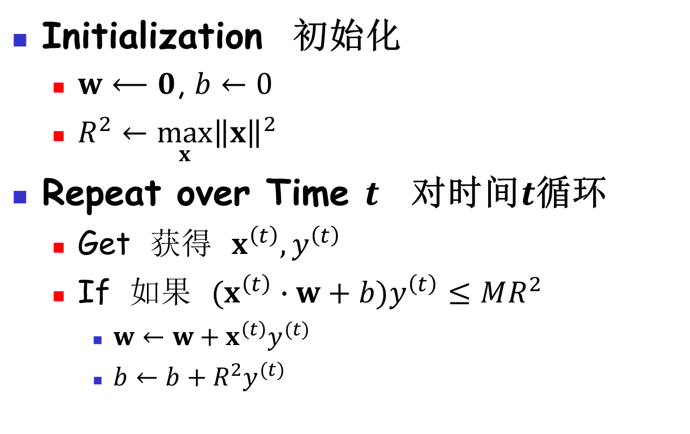
Perceptron Algorithm w/ Margins 带间距的感知器算法
Initialization 初始化
  $w⟵0$, $b←0$
  $R^{2}←\max_{x}{{\left\|x\right\|}^{2}}$
Repeat over Time $t$ 对时间$t$循环
  Get 获得 $x^{\left(t\right)},y^{\left(t\right)}$
  If 如果 $(x^{\left(t\right)}∙w+b)y^{\left(t\right)}≤MR^{2}$
    $w←w+x^{\left(t\right)}y^{(t)}$
    $b←b+{R^{2}y}^{(t)}$

Slide 21
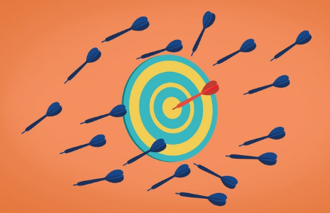
Practice 7.1 实践7.1
Practice time: use perceptron w/ margins on the synthetic problem
实践时刻：在人造问题上使用带间距的感知器
How does it perform comparing w/ simple perceptron?
和简单的感知器相比，它的表现如何？

Slide 22
Result 结果
Perceptron w/ margins performs better
带间隔的感知器表现更好

Slide 23
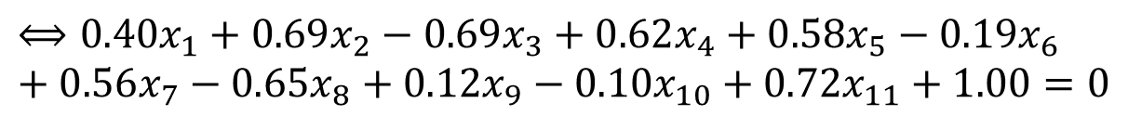
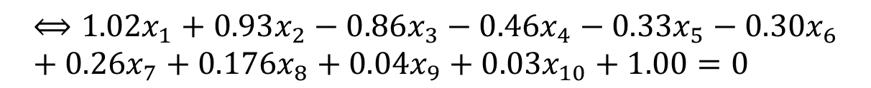
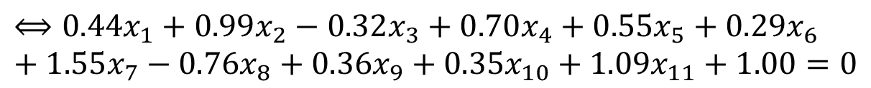
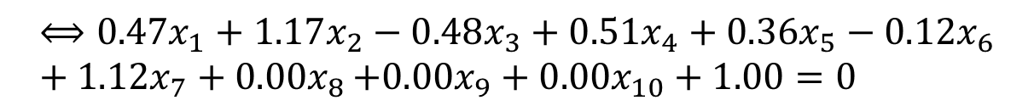
Example 实例 (1)
Ground truth classification boundary 真实分类边界
$$⟺{1.02x}_{1}+0.93x_{2}−0.86x_{3}−0.46x_{4}−0.33x_{5}−0.30x_{6}+0.26x_{7}+0.176x_{8}+0.04x_{9}+0.03x_{10}+1.00=0$$
Learned w/ 7 attributes w/o margins 不带间距用7个属性学习到的
$$⟺{0.47x}_{1}+1.17x_{2}−0.48x_{3}+0.51x_{4}+0.36x_{5}−0.12x_{6}+1.12x_{7}+0{.00x}_{8}+0.00x_{9}+0.00x_{10}+1.00=0$$
Learned w/ 11 attributes w/o margins 不带间距用11个属性学习到的
$$⟺{0.44x}_{1}+0.99x_{2}−0.32x_{3}+0.70x_{4}+0.55x_{5}+0.29x_{6}+1.55x_{7}−0.76x_{8}+0.36x_{9}+0.35x_{10}+1.09x_{11}+1.00=0$$
Learned w/ 11 attributes w margins 带间距用11个属性学习到的
$$⟺{0.40x}_{1}+0.69x_{2}−0.69x_{3}+0.62x_{4}+0.58x_{5}−0.19x_{6}+0.56x_{7}−0.65x_{8}+0.12x_{9}−0.10x_{10}+0.72x_{11}+1.00=0$$

Slide 24
Example 实例 (2)
 | w₁ | w₂ | w₃ | w₄ | w₅ | w₆ | w₇ | w₈ | w₉ | w₁₀ | w₁₁ | b
T | 1.02 | 0.93 | -0.86 | 0.46 | 0.33 | 0.30 | 0.26 | 0.16 | 0.04 | 0.03 | 0.00 | 1.00
7 | 0.47 | 1.17 | -0.48 | 0.51 | 0.36 | -0.12 | 1.12 | 0.00 | 0.00 | 0.00 | 0.00 | 1.00
11 | 0.44 | 0.99 | -0.32 | 0.70 | 0.55 | 0.29 | 1.55 | -0.76 | 0.36 | 0.35 | 1.09 | 1.00
11-M | 0.40 | 0.69 | -0.69 | 0.62 | 0.58 | -0.19 | 0.56 | -0.65 | 0.12 | -0.10 | 0.72 | 1.00
In learning w/ 11 attributes, the overrating or incorrect rating issue gets alleviated
用11个属性学习时，高估和错估的问题被改善了

Slide 25
What’s the Insight?
我们洞察到了什么？
Perceptron w/ Margins 带间距的感知器
  Perform better in the synthetic problem
  在人造问题中表现更好
The Question 问题是
  How is that relevant to Occam’s Razor in terms of classification capability of candidate classifier set 这和关注候选分类器集合的分类能力的奥卡姆剃刀有关吗？
  We start from a math theorem
  我们从一个数学定理开始

Slide 26
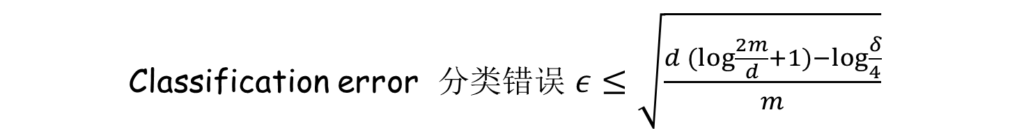
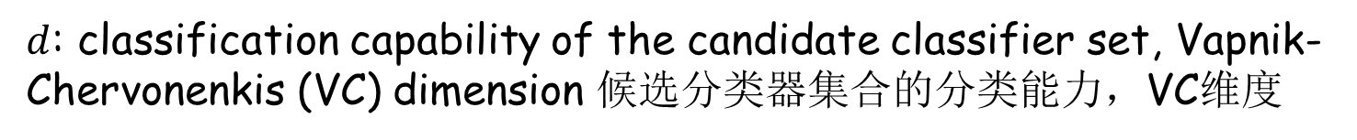
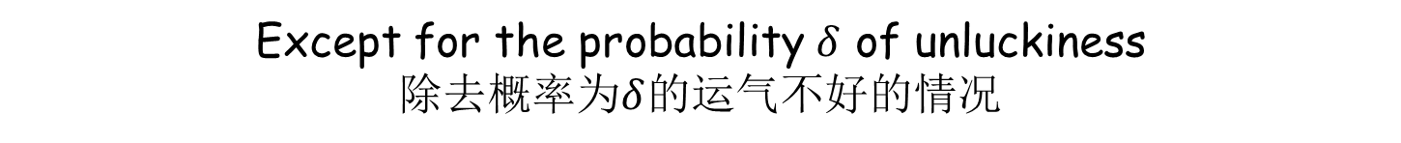
Math Theorem 数学定理
$m$: number of training samples 训练数据数量
$d$: classification capability of the candidate classifier set, Vapnik-Chervonenkis (VC) dimension 候选分类器集合的分类能力，VC维度
$δ$: tolerance of probability of unluckiness 能忍受的运气不好的概率
A classifier learned given all training samples correctly classified
学习到一个正确分类了所有训练数据的分类器
Classification error 分类错误 $ε≤\sqrt{\frac{d(log{\frac{2m}{d}}+1)−log\frac{δ}{4}}{m}}$
Except for the probability $δ$ of unluckiness
除去概率为$δ$的运气不好的情况

Slide 27
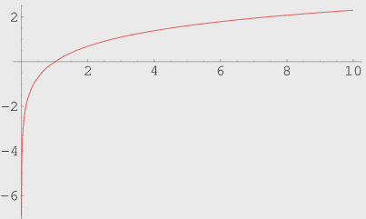
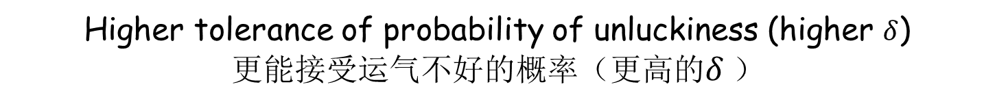
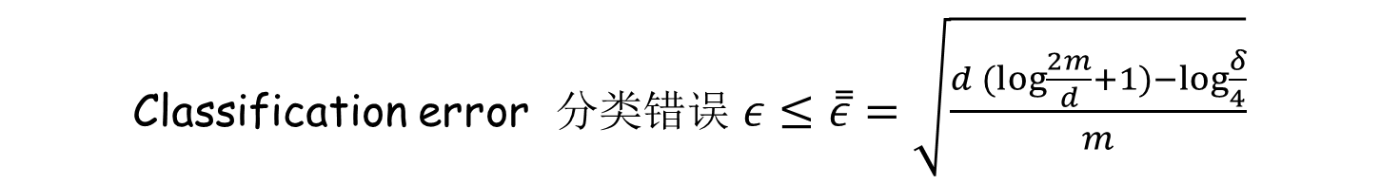
Upper Bound of Error 错误上界
Classification error 分类错误 $ε≤\overset{̿}{ε}=\sqrt{\frac{d(log{\frac{2m}{d}}+1)−log\frac{δ}{4}}{m}}$
Higher tolerance of probability of unluckiness (higher $δ$)
更能接受运气不好的概率（更高的$δ$）
Lower upper bound of error $\overset{̿}{ε}$ 更低的错误上界
Because we tolerate more exceptions
因为我们能接受更多的例外

Slide 28
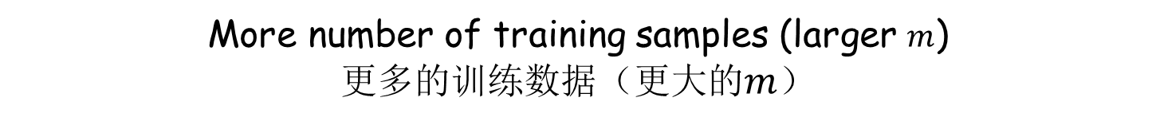
Upper Bound of Error 错误上界
Classification error 分类错误 $ε≤\overset{̿}{ε}=\sqrt{\frac{d(log{\frac{2m}{d}}+1)−log\frac{δ}{4}}{m}}$
More number of training samples (larger $m$)
更多的训练数据（更大的$m$）
Lower upper bound of error $\overset{̿}{ε}$ 更低的错误上界
Because we have seen & adapted to more data, less likely we encounter unexpected cases in the future
因为我们已经看到并适应于更多的数据，将来遇到意外的情况的可能性就越小

Slide 29
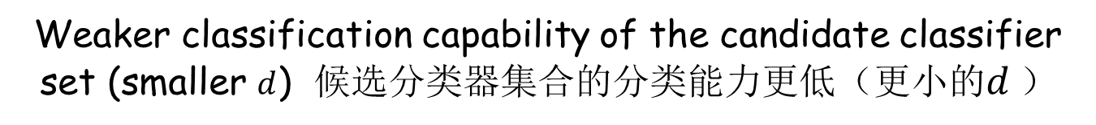
Upper Bound of Error 错误上界
Classification error 分类错误 $ε≤\overset{̿}{ε}=\sqrt{\frac{d(log{\frac{2m}{d}}+1)−log\frac{δ}{4}}{m}}$
Weaker classification capability of the candidate classifier set (smaller $d$) 候选分类器集合的分类能力更低（更小的$d$）
Lower upper bound of error $\overset{̿}{ε}$ 更低的错误上界
Occam’s Razor in machine learning (proved in math)
（被数学证明的）机器学习中的奥卡姆剃刀
We are not going through the proof or the exact definition of VC dimension (classification capability), but will provide an intuitive explanation 我们不会讲这个证明或VC维（分类能力）的准确定义，但会给出一个直观的解释

Slide 30
Classification Capability
分类能力
Candidate Classifier Set
候选分类器集合
  Contain many candidate classifiers
  包含了很多候选分类器
Its Capability 它的能力
  If we can always handle different complex classification problems w/ right candidate classifiers from the set
  如果我们总是能用该集合中合适的候选分类器来处理各种复杂的分类问题
  Then its capability is strong & vice versa
  那么它的能力就很强，反之则弱

Slide 31
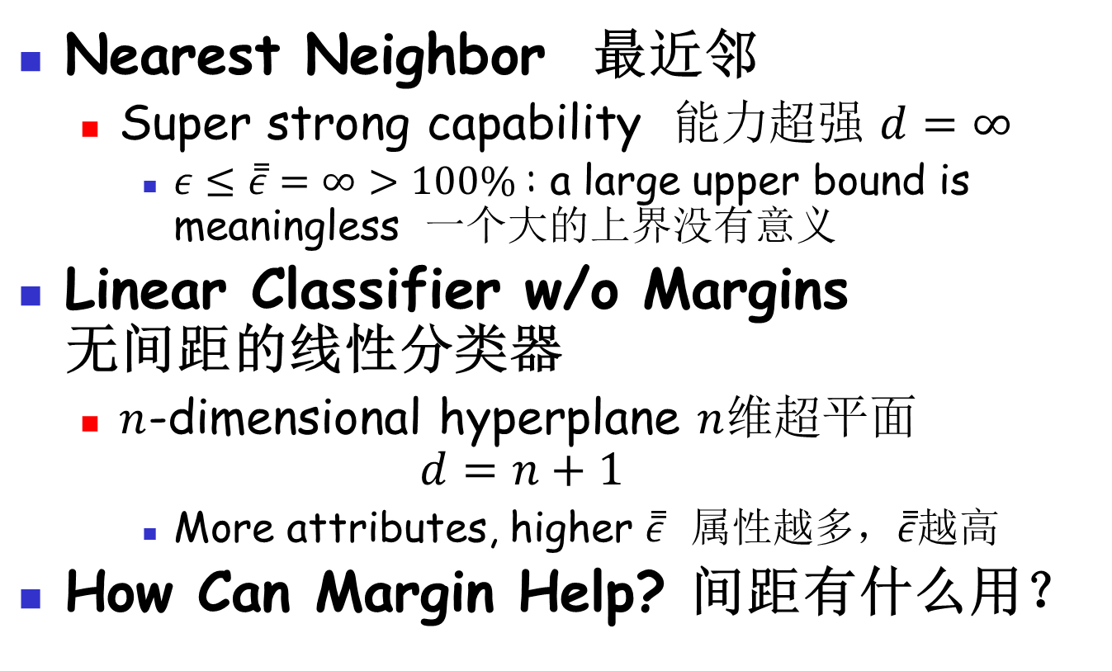
VC Dimension VC维
Nearest Neighbor 最近邻
  Super strong capability 能力超强 $d=∞$
    $ε≤\overset{̿}{ε}=∞>100\%$: a large upper bound is meaningless 一个大的上界没有意义
Linear Classifier w/o Margins
无间距的线性分类器
  $n$-dimensional hyperplane $n$维超平面
  $$d=n+1$$
    More attributes, higher $\overset{̿}{ε}$ 属性越多，$\overset{̿}{ε}$越高
How Can Margin Help? 间距有什么用？

Slide 32
Margin & VC Dimension
间距和VC维 (1)
  Attribute 2 属性2
Given some data
给定一些数据
  Attribute 1
  属性1
Any line is a candidate w/o margins
不考虑间距，每条线都是一个候选分类器

Slide 33
Margin & VC Dimension
间距和VC维 (1)
  Attribute 2 属性2
Some lines are eliminated from the candidate set
一些直线从候选集中被剔除了
Given some data
给定一些数据
Required margin
间距
  Attribute 1
  属性1
Setting a required margin
设置一个间距
Less candidates remain in the set
留在集合中的候选少了

Slide 34
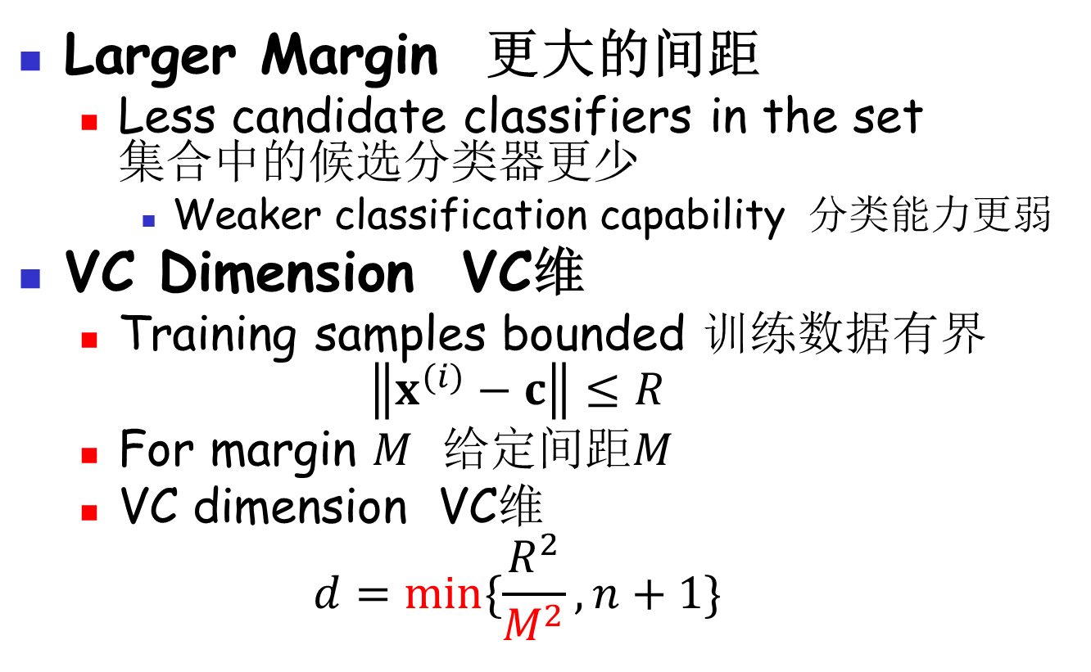
Margin & VC Dimension
间距和VC维 (2)
Larger Margin 更大的间距
  Less candidate classifiers in the set
  集合中的候选分类器更少
    Weaker classification capability 分类能力更弱
VC Dimension VC维
  Training samples bounded 训练数据有界
  $$\left\|x^{(i)}−c\right\|≤R$$
  For margin $M$ 给定间距$M$
  VC dimension VC维
  $$d=min⁡\{\frac{R^{2}}{M^{2}},n+1\}$$

Slide 35
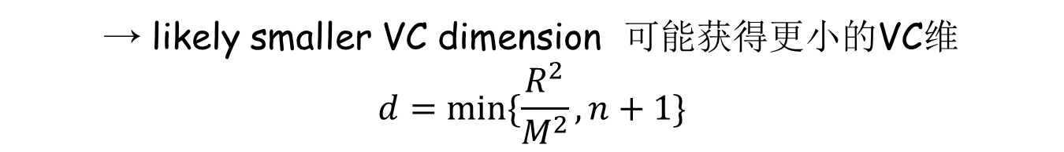
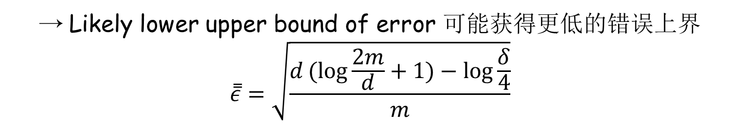
Margin & VC Dimension
间距和VC维 (3)
Larger margin 间距越大
→ likely smaller VC dimension 可能获得更小的VC维
$$d=min⁡\{\frac{R^{2}}{M^{2}},n+1\}$$
→ Likely lower upper bound of error 可能获得更低的错误上界
$$\overset{̿}{ε}=\sqrt{\frac{d(log{\frac{2m}{d}}+1)−log\frac{δ}{4}}{m}}$$

Slide 36
Practice 7.2 实践7.2
Practice time: use perceptron w/ margins on word sense disambiguation
实践时刻：将带间距的感知器用于词义消歧
Does it perform better? 它是否有更好的表现？

Slide 37
Result 结果
Methods 方法 | Accuracy 准确率
Nearest neighbor 最近邻 | 69.3%
Perceptron 感知器 | 83.6%
Perceptron w/ margin 带间距的感知器 | 85.7%

Slide 38
The End

